Slide 1
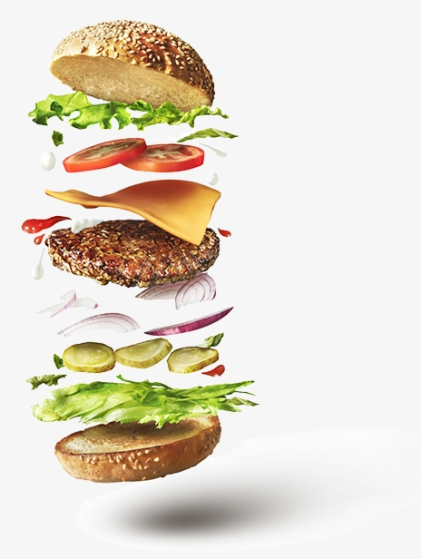
Food Snap
Presented by Brandon Steinke, Patrick Hennessey, & Anna Favis

Slide 2
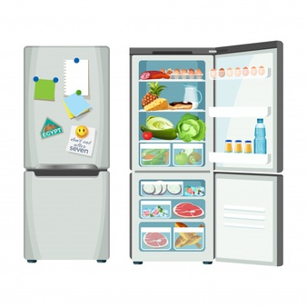


Summary
The problem – What to cook and how ?
The Goal was to create an app that would allow users to take photos of various ingredients they had in the kitchen
Then use Machine Learning to Detect the ingredients in users’ photo(s)
To Provide users with recipe ideas based on those ingredients

Slide 3
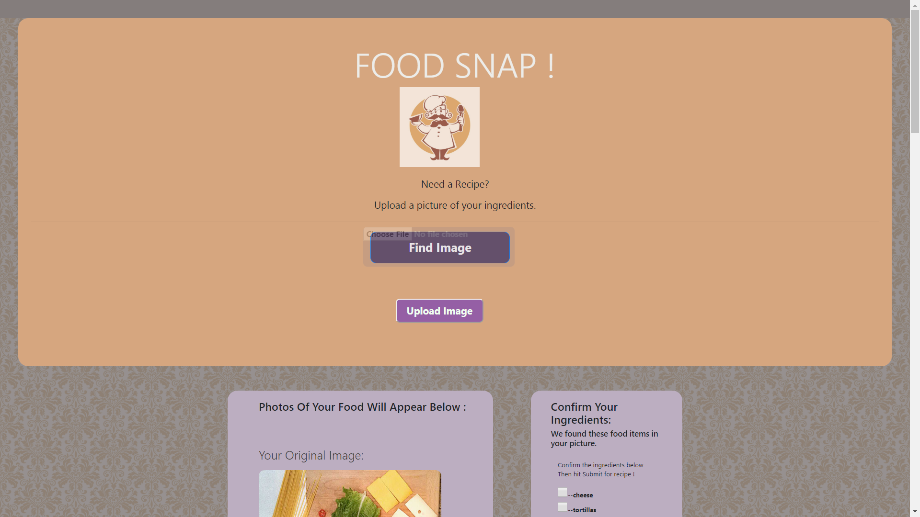
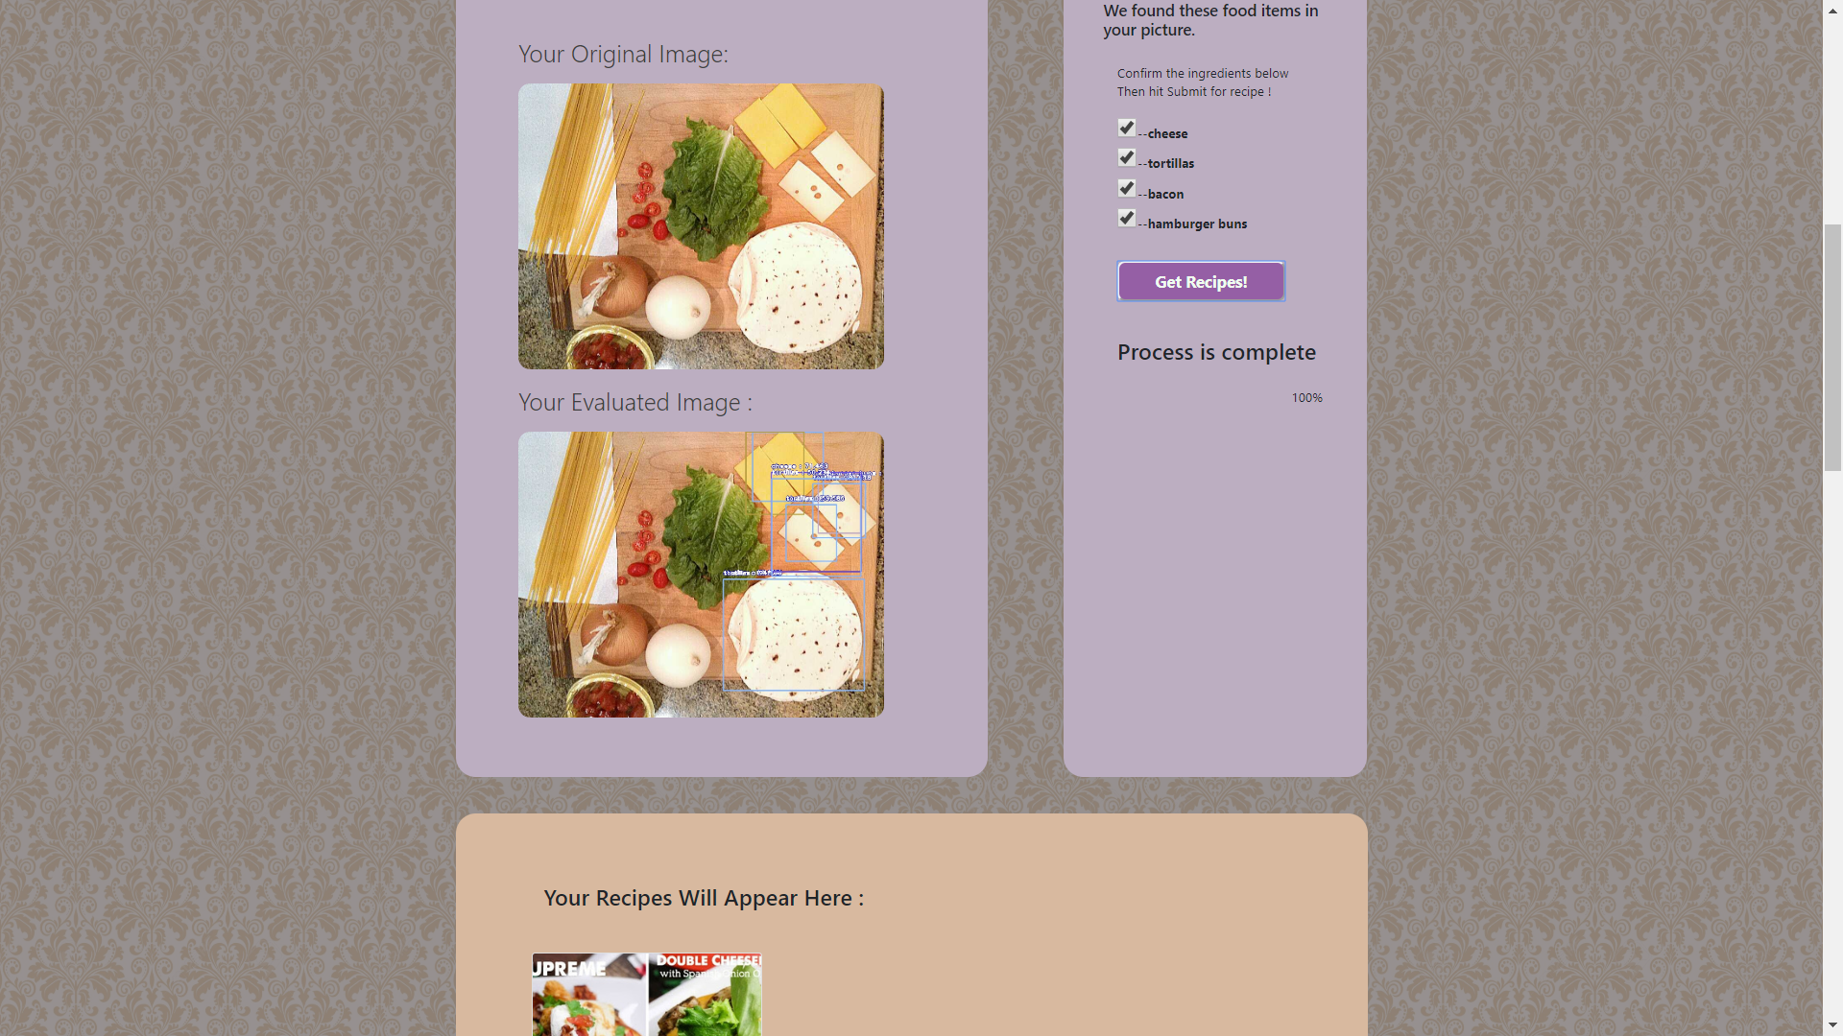
Demo App: $ python app.py

Slide 4
Image Classification – Patrick The ML Coach!
Chose and implemented the ML Image Classification Model / Library for the app
Manually Downloaded and Classified 9 Million Images by hand
Coached and Trained the Image Detection Model ( 10 Hours)
Provided all ML code /Model files for Flask Integration

Slide 5
Site Architect=>(Flask/HTML/D3/JavaScript) Brandon
Established HTML template: with Bootstrap elements, used basic HTML Input Form Method=“ Post” to locate image in folder and communicate image name to Flask
Flask Server: for various API calls to perform tasks (such as image placement and Running ML Model) based on User input (clicking submit buttons)
Flask/Jinja: to populate certain elements of the website (ingredients from Model)
D3 JavaScript: to listen to events in the HTML, gather values from HTML and Insert certain HTML elements (such as the checkboxes)
CSS: / and HTML In-line style to format HTML elements
JavaScript within HTML: to run progress bars, and D3 to control their visibility
Overall Site Integration

Slide 6
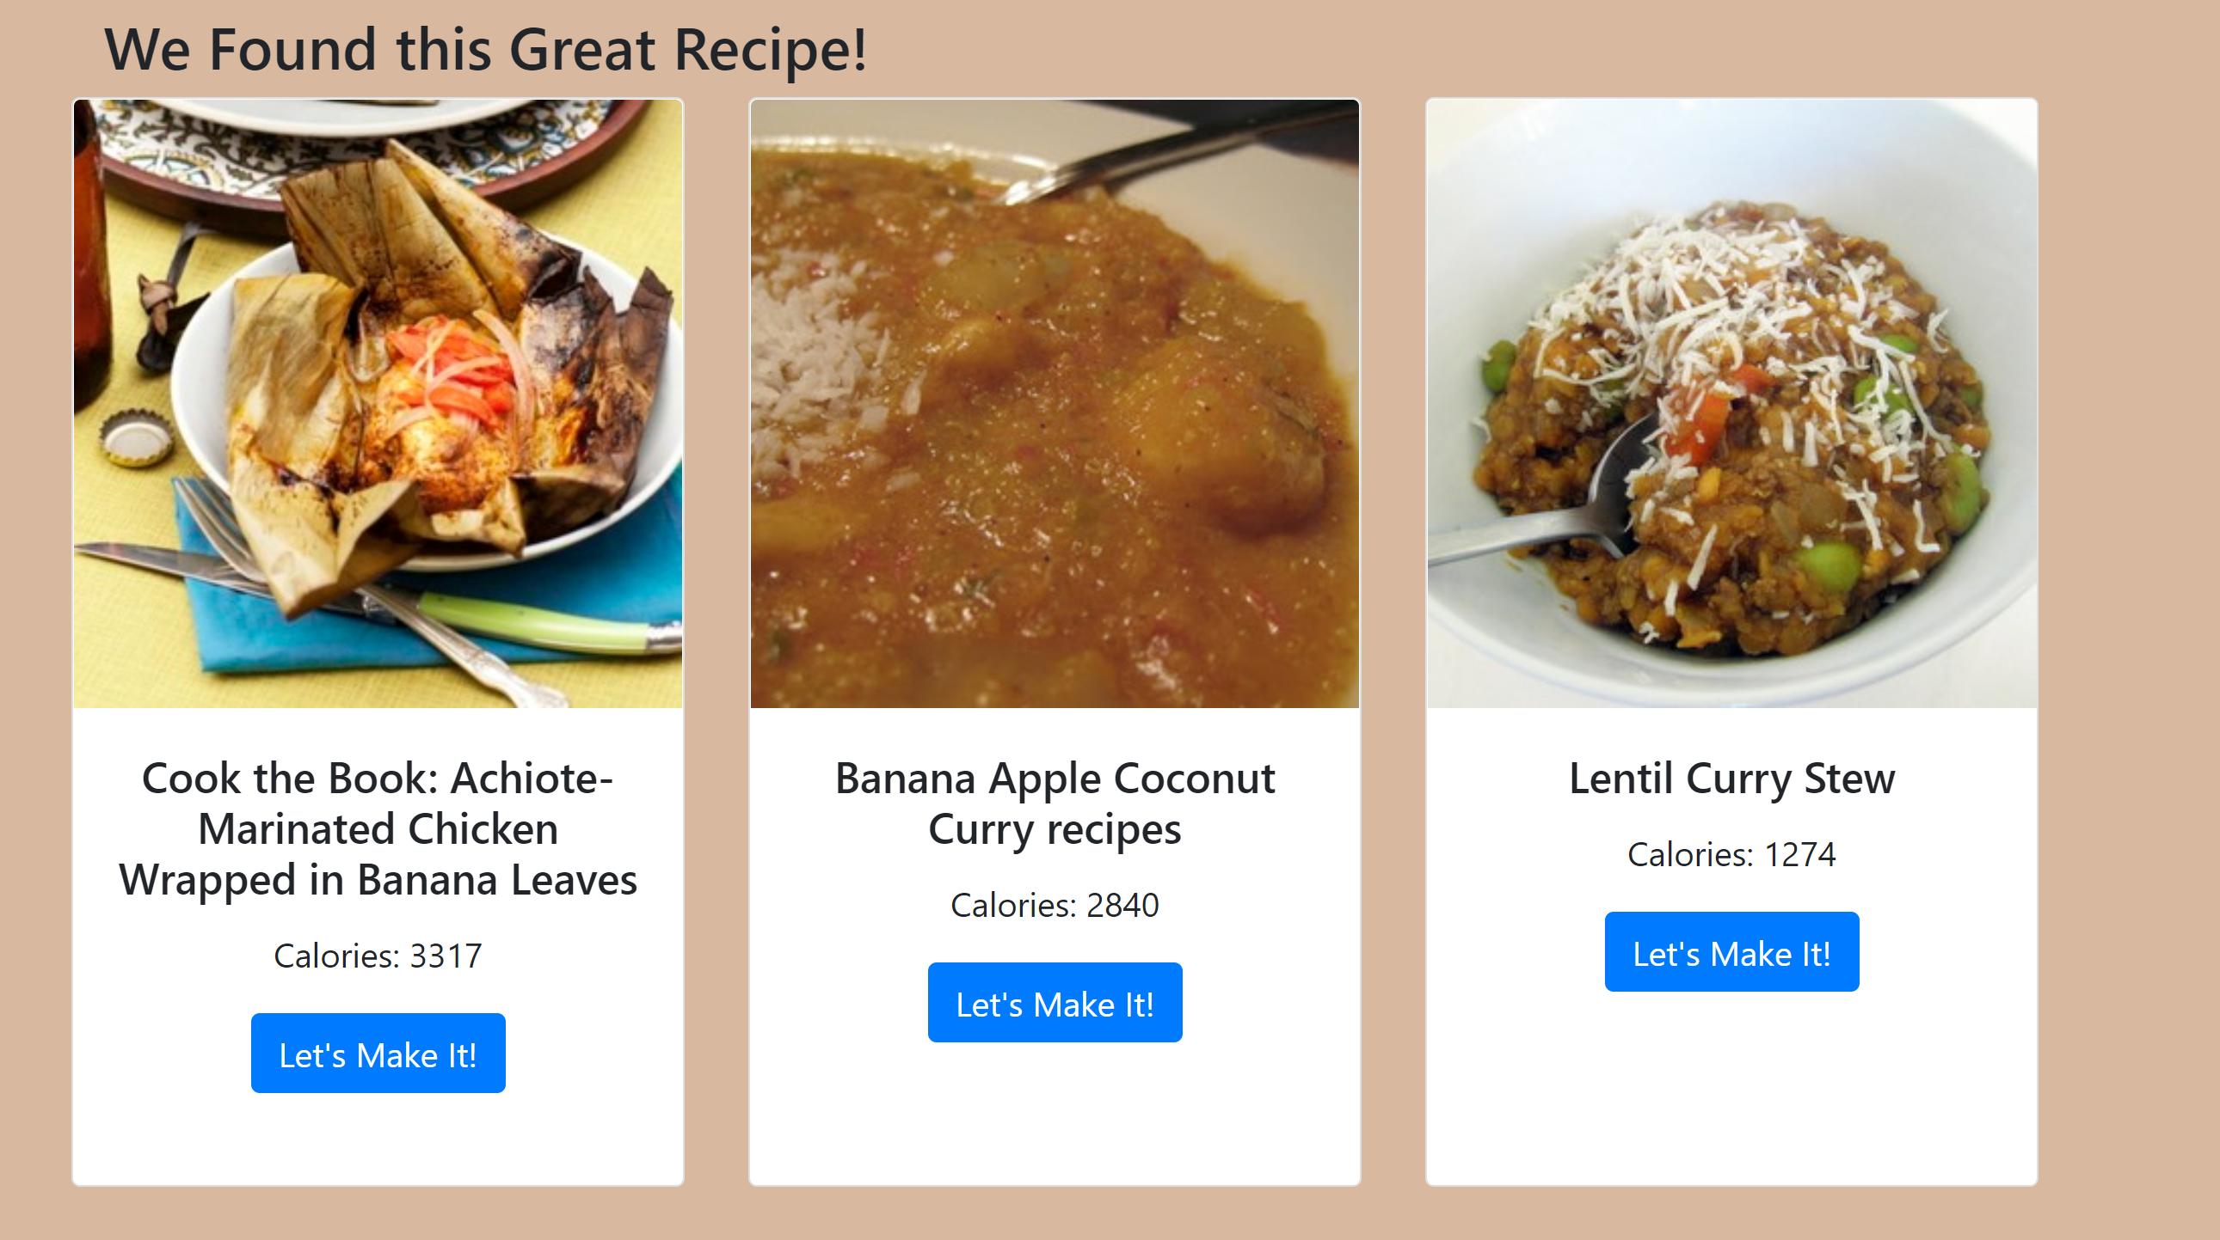
Recipe Search – Anna (API Guru)
Wrote Python app to query results from Edamam API
Extrapolate recipe name, calories, image link, recipe url
D3 adds the top three recipes onto the HTML template:

Slide 7
Recap / Questions / Comments ….
Discuss: challenges, pivots, “Oh NO” moments, victories
Tech Summary:
ImageAi Machine Learning Yolo Model
Python / Flask / Jinja
HTML, CSS, D3 JavaScript, JSON
The hard-working Team at Food Snap ©
Thanks you for your time!

